Slide 1
Financial Stress

Slide 2



Agenda
Overview of different financial programs
Current landscape of Canadian households
Is financial stress common?
Impact on financial stress
Tips for reducing stress level
1
2
2
3
4
5

Slide 3
1
1
Overview of different financial programs to manage current crisis

Slide 4

Current financial programs
Canada Emergency Response Benefit
We will provide a taxable benefit of $2,000 every 4 weeks for up to 16 weeks to eligible workers who have lost their income due to COVID-19. The Benefit is available to workers:
Residing in Canada, who are at least 15 years old;
Who have stopped working because of reasons related to COVID-19 or are eligible for Employment Insurance regular or sickness benefits
Who had employment and/or self-employment income of at least $5,000 in 2019 or in the 12 months prior to the date of their application;
Who have not quit their job voluntarily.
Canada Child Benefit
The government is providing up to an extra $300 per child through the Canada Child Benefit (CCB) for 2019-20. This will mean approximately $550 more for the average family.
Registered Retirement Income Funds (RRIFs)
The minimum withdrawal rate for RRIFs has dropped by 25% for 2020. A similar decrease will apply to those receiving variable benefit payments under defined-contribution pension plans.

Slide 5
Current financial programs
Extra time to file income tax returns
The filing due date for 2019 income tax returns for individuals has been deferred until June 1, 2020. For trusts with a taxation year ending on Dec. 31, 2019, the filing deadline is now May 1. Any new income tax balances due, or instalments, are also being deferred until after August 31, 2020 without incurring interest or penalties. The Canada Revenue Agency has also halted debt collection.
Suspending repayment and interest on student and apprentice loans
All student loan borrowers will automatically have their loan repayments and interest suspended until September 30, 2020.
Mortgage deferral
Banks are offering up to 6 months of mortgage deferral. Be careful interest will be added back.
Credit cards
Banks are offering clients in financially difficulty lower interest rates costs on their credit cards and no minimum payment required.

Slide 6

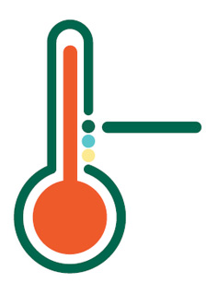
1
2
Current landscape of Canadian households

Slide 7

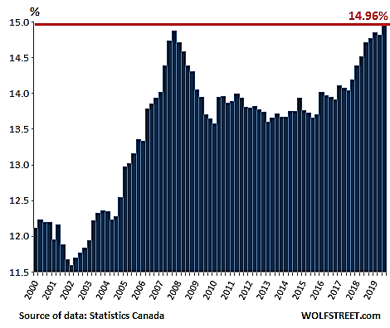
Debt service as % of available income for Canadian Household from 2000 to 2019
1

Slide 8
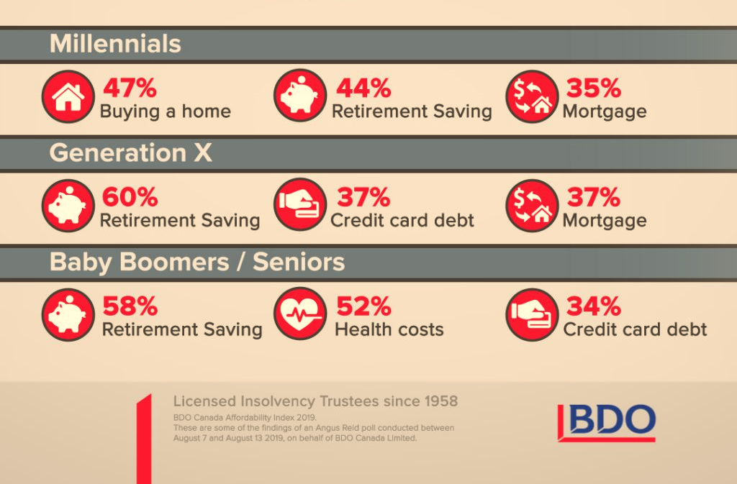

Major financial challenges by generations
1

Slide 9
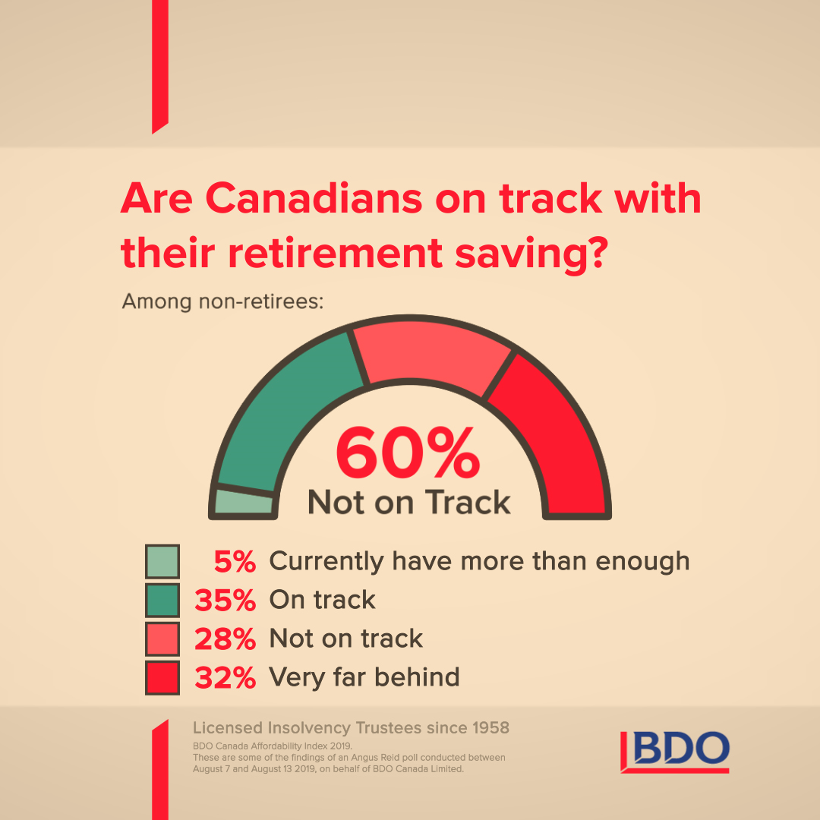
Canadians retirement saving
1

Slide 10

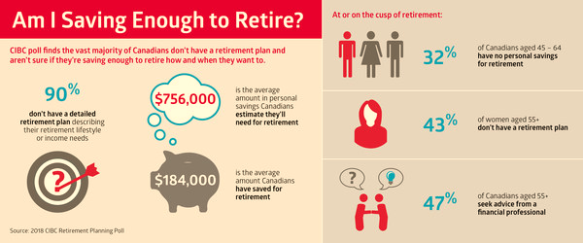
Canadians retirement saving
1

Slide 11


1
3
  Is financial stress common

Slide 12
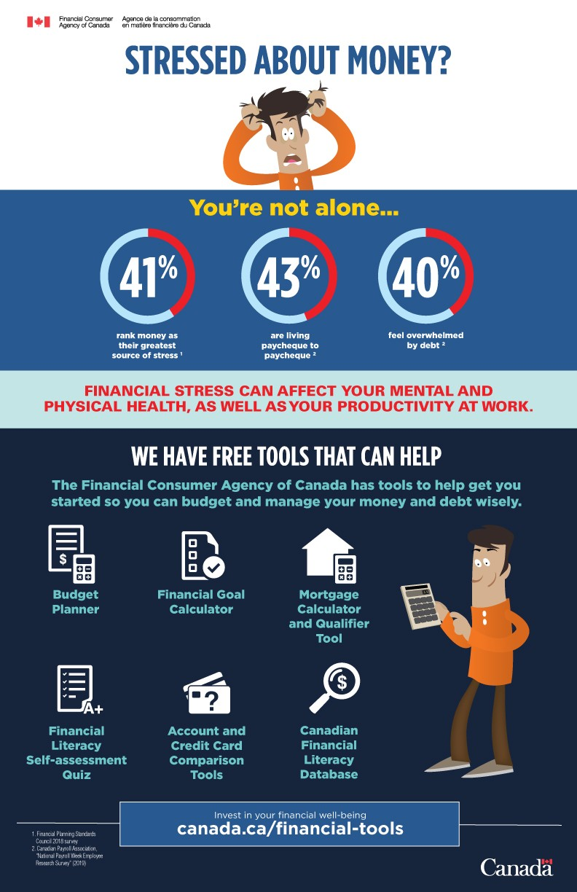
Money and Stress
1

Slide 13
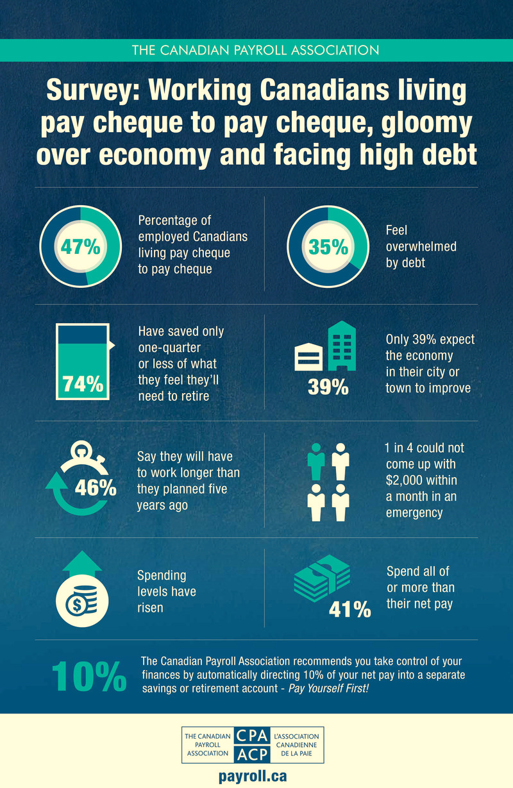
Roughly 50% of Canadians are living from paycheque to paycheque
1

Slide 14
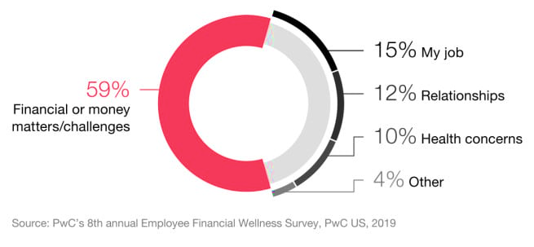

Finances are the main cause of stress
1

Slide 15


4
Impact on financial stress

Slide 16


Stress or Anxiety
1
Stress
Is a condition in which people fear failure but are still able to take action and tackle their problems. You need encouragement and make sure to move forward. Look for support in overcoming the task or problem at hand.
Anxiety
On the other hand, anxiety is a condition in which people are debilitated by worry and are often unable to take action, let alone discuss the problem without distress. For people with financial anxiety, a third party advisor can be most helpful by giving them an opportunity to talk through their feelings, helping them better understand their problem, and providing moral support and encouragement.

Slide 17
Stress on your Body
1
Stress is normal and can be optimal for certain performance related tasks
Stress can help create a sense of urgency and forces one to take action
Stress becomes an issue when:
  It interefers with a person’s ability to do their daily tasks
  It impacts health in a dangerous or risky way
  It interefers with their family lives
  It turns into anxiety

Slide 18


Financial Stress
Health
People who are dealing with financial stress are 2X as likely to report poor overall health and 4X as likely to suffer from sleep problems, headaches and other illnesses.
Mental health
In the long term, high financial stress can lead to serious health issues like heart disease and high blood pressure, as well as mental health problems like depression and anxiety, not to mention the increased tension in interpersonal relationships
1

Slide 19

Warning signs that you are experiencing financial stress
1
• Change in appetite (eating more or less);
• Anxiety;
• Irritability;
• Difficulty concentrating;
• Lack of energy;
• Lack of motivation;
• Abnormal social isolation;
• Mood disorder, depression in certain cases;
• Signs of addiction (gambling, alcohol, cigarettes, drugs);
• Maxing out credit cards and lines of credit out of necessity.

Slide 20


5
Tips for reducing stress level

Slide 21

Solutions are available
1
Why not take this opportunity to review your budget?
A good starting point is identifying sources of financial stress. This will help you take action. Remember that sound financial management starts with a realistic budget. Here are a few things you can do:
Ask your financial institution about what they can provide in terms of relief during the crisis.
Lower the limit on your credit card and restrict yourself to just one card. Use credit only when you are sure you can pay the monthly balance.
Separate good debt from bad debt. Investing is good debt (mortgages, RRSPs), and limit bad debt.

Slide 22

Solutions are available
1
Use notifications and reminders to make sure you pay your accounts on time and avoid interest fees.
Be wary of buy-now-pay-later offers.
Despite the relief proposed by various levels of government, it is best to continue to pay your city taxes and mortgage payments if you can afford to.
Avoid making impulse purchases online. Before buying, sleep on it.
Consult the assistance provided to Canadians by the federal and provincial governments.
Consult your financial institution. Debt consolidation may be your best option.

Slide 23
Coping with Financial Stress
1
Focus on your priorities and very important to set goals
Goal setting is crucial to achieving success
Talk about your worries
Communication helps to feel supported
Recognize unhealthy habits(challenging to change an old habit)
Research shows it takes 21 days to break a habit
Identify your stressors and make a plan
Important to create a short, medium and long term plan

Slide 24

Coping with Financial Stress
1
Substitute your old habits to healthier habits
Better habits reduce stress
Review your plan and don’t be afraid to adjust it
Regular review of a plan helps with accomplishing your goals
Track your progess and celebrate small milestones
Monitor your results and be proud of achieving them.

Slide 25
Ways to manage financial stress in a family setting
1
Some tips during times of financial stress are:
Work together to set goals and make a clear and realistic budget and plan to get through the situation. You may like to hold a family meeting to talk about how everyone can contribute.
You may like to explain your situation to your children. It’s a good idea to do this in a calm and simple way. Explain that it’s no one’s fault – there are lots of families having difficulty at the moment.
Talk to your children about money. Explain that a certain amount of money comes in regularly and talk about what you normally spend it on. This may help when they ask for things the family cannot afford.

Slide 26

Ways to manage financial stress in a family setting
1
Think about letting your extended family know of your situation. They may be able to help with child care, finding a job, a loan or advice on managing money.
Make sure you and your children don’t go without essentials. Spend your money on things like food, rent or mortgage payments, heating, clothes and school costs first.
Check in with your family regularly to see how they are feeling. The most valuable thing you can give your loved ones is time.
Remember, to be able to take care of your loved ones, you need to make sure you look after yourself.

Slide 27
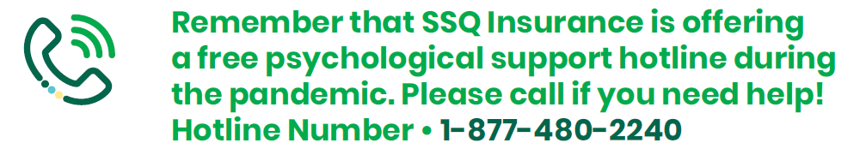
SSQ Insurance is here to help
1
SSQ Insurance is lending its support as sponsor of the program called Stronger Minds by BEACON, a mental health organization.
Also, SSQ Insurance is supporting Morneau Sepell’s WellCan initiative, a free application designed to help developing coping strategies, building resilience and get access to free confidential counseling.

Slide 28
Thank you for paying attention!
1
Our next Virtual Meetings will be focused on the Role of Sleep. Join us on June, 3rd
For more information, consult our virtual meetings Webpage at this adress: https://ssq.ca/en/virtualmeetings

